Slide 1
Business Leadership Program
E-commerce platform of
recreation & entertainment
from Tinder Box

Slide 2
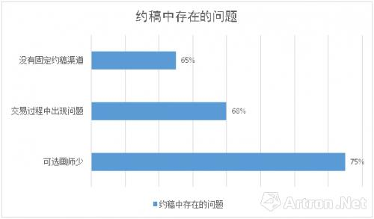
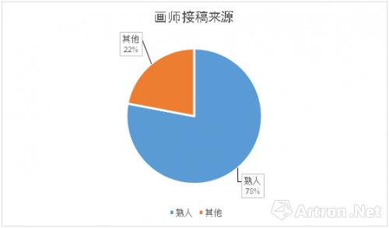
Customer Traction
Problems during purchasing Customized drawings
Customers of individual painters
Current Market Problems
Others
22%
Lack of fixed channel
65%
Data from Atron.net
NO CHANNEL
Problems about transaction stage
The Creators
The Buyers
68%
Requests Unsatisfied
Lack of Orders
Other problems:
Copyright Protection, Unfair Prices, Communication problems
……
Lack of available painter
75%
Acquaintance
78%

Slide 3
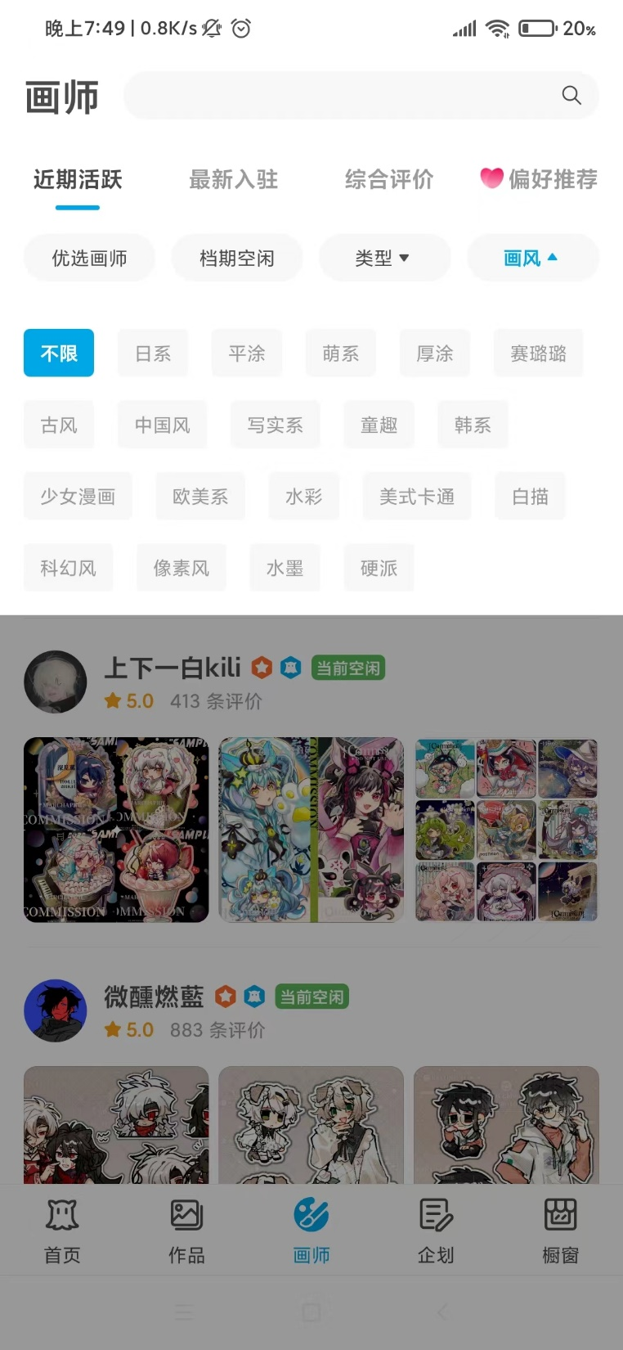
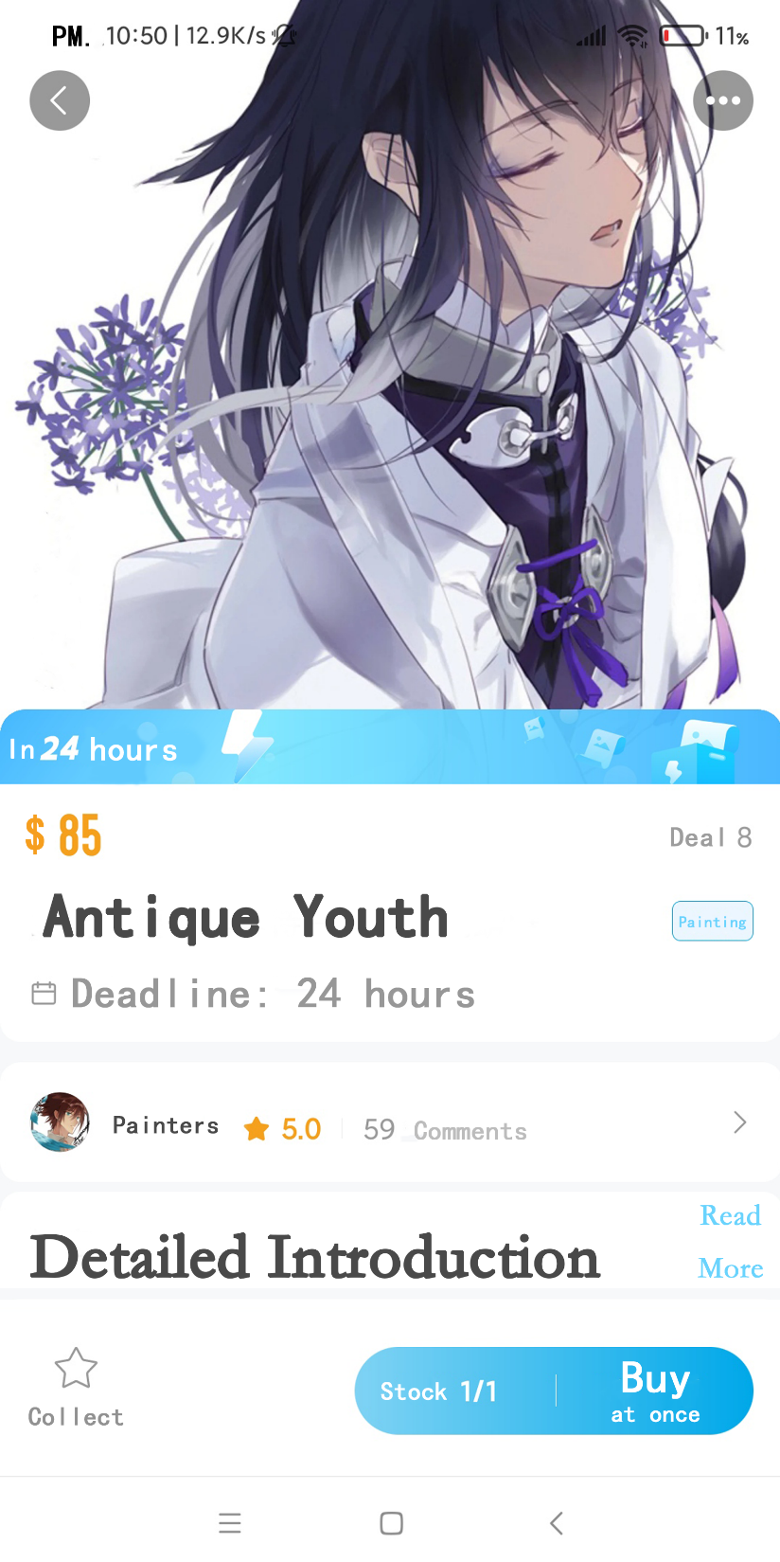
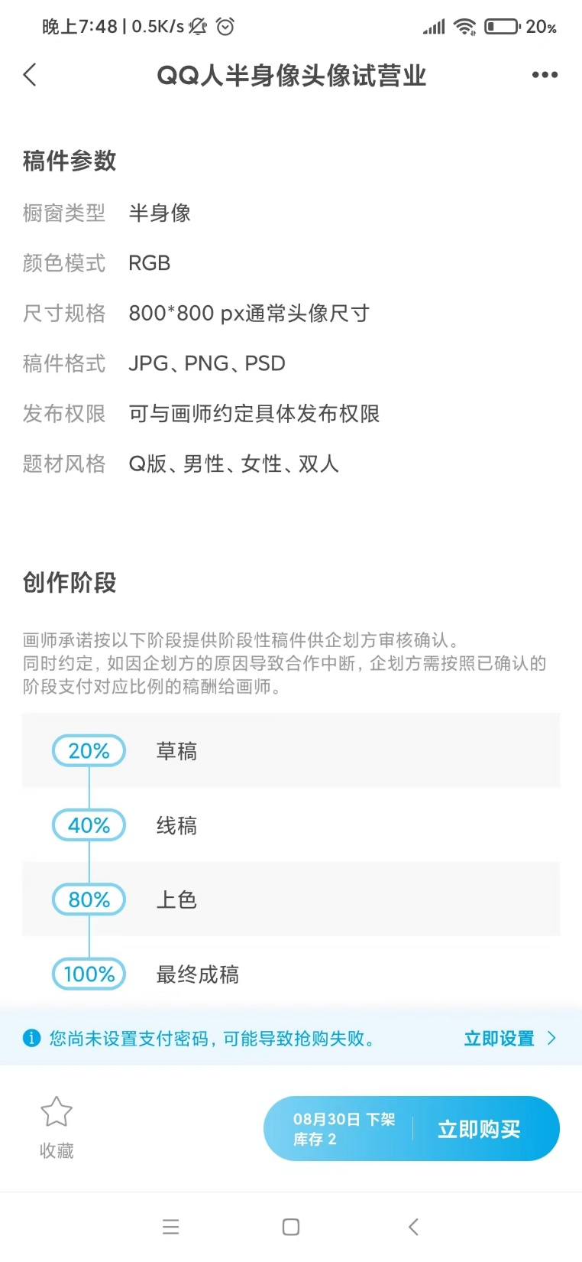
Manuscript
Parameters
Former
Works
Screening
Creation stage
View for buyers

Slide 4
Our Solution
Use big data to match two ends according to requests ang skills.
Data
Chains
Blocks
Buyers
Creators
Multible blocks contain various entertainment areas.
Separate the producing step and form complete chains.
Monitor
Confirm the progress and satisfaction during the process.

Slide 5
Customer Traction
Traditional Trading Channels
KOS&KOL
Cultural Circles
Initial Customers

Slide 6
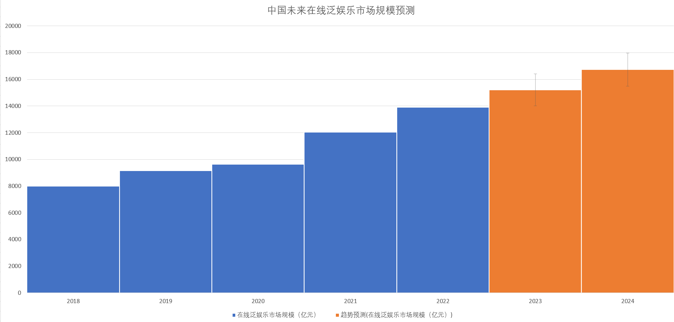
China’s future pan entertainment market procast
Scalable Advantage
Separate Industrial Chains
$2372.8 billion
$2076.2 billion
$1779.6 billion
Create&Recreate
Intellectual
Property
Build
Industrial Chains

Slide 7
Industry:
Culture assisted production and intermediary services
$113 billion
first half of this year
User Quantity
3 Million
……
30K
50K
534K
INDIVIDUAL CREATORS
Data from National Bureau of Statistics, AskCI.com, Baidu, Lofter, NetEase CloudMusic
4K
100K
400k
30K

Slide 8
Competition- USP
 | Taobao | Xianyu | Wangyi (Music BeatSoul） | Weibo | MiHuashi
Service Convenience | × | × | × | × | √
Retrieval convenience | √ | √ | × | × | √
After-sale Service | × | × | × | × | ×
Transaction guarantee | × | × | × | × | √
Userretention | √ | √ | √ | √ | ×
Talent Strategy | × | × | √ | × | ×
Sales promotion | √ | √ | × | √ | ×
Market Concentration | × | × | × | × | ×
User Quantity | √ | √ | √ | √ | ×
A Survey of Our Competitors

Slide 9
Go-to-market Plan：
HOW TO COOPERATE
Buyers & Artists
Artists & Artists
Set up a feedback mechanism within the platform.
Set the promotion and promotion fees and rental levels of resident creators.
Cooperate Model
Cooperate Model
Pay attention to copyright issues and maintain a good brand image.
Sign up at a low cost, build a creative team belonging to the platform .

Slide 10
Go-to-market Plan：
HOW TO ATTRACT ?
At initial stage:
Free promotion on the
platform to attract creators.
Use wechat or Taobao applet
to realize initial trading
and platform drainage.
At later stage:
Introduce more
professional studios to expand
the market.
Cooperate with relevant interest
course learning institutions,
Attract consumers and creators
to register as VIP members.

Slide 11
Business Model
Peer to Peer (P2P)
Sharing of Asset
Owner
Seeker
Recommendation
Access to Market
Service Fee
Request
Access to Market
Offer
Renting Fee
Renting Fee
Platform

Slide 12
Milestones
Official operation
Expanding market
Industrial chain
Platform Construction
And trial operation
6
MONTH
1
YEAR
3
YEAR
5
YEAR
Advertising
Free membership
Mainly for individuals
Art communication and education
100,000 downloads
Free membership
Looking for entertainment company cooperation
1 million users
Paid membership
Individuals to industries
Standard audit and problem-solving mechanism
1 million orders, 10 million turnover
Original culture IP

Slide 13
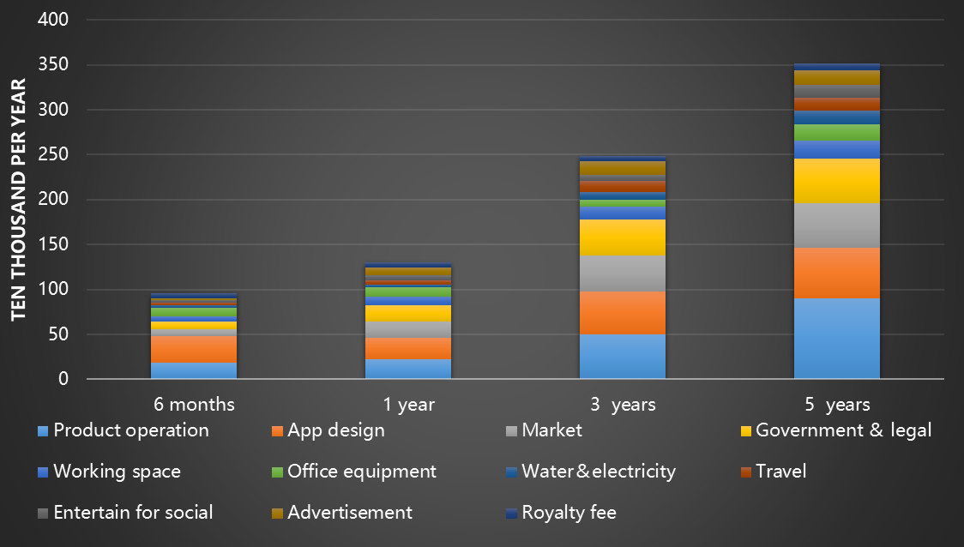
Use of budget
Human cost
Non-human cost

Slide 14
Gong Yuwei, Chinese,
one of the creators in cultural&entertainment circles, having long-term experience of creating and research of creators' psychology. Having access to relative networks of creators market.
My name is Yang Luguo.
I am a undergraduate major in mathmatics I am talented in programming and collecting materials.
Fan Miao, major in Geographic information science and remote sensing, good at integrate information and communication.
Tailin Song, major in Artificial Intelligence,
skilled in data processing and algorithm implementation
Wenxin Zhou, major in phyical geography, skilled at App construction and technical maintenance
Runing zhang, major in Information management and Information System. good at data analysis, planning and operation.
Dongxin Li, major in human geography,
Good at geospatial analysis.

Slide 15
Thanks for Listening
from Tinder Box

